Slide 1
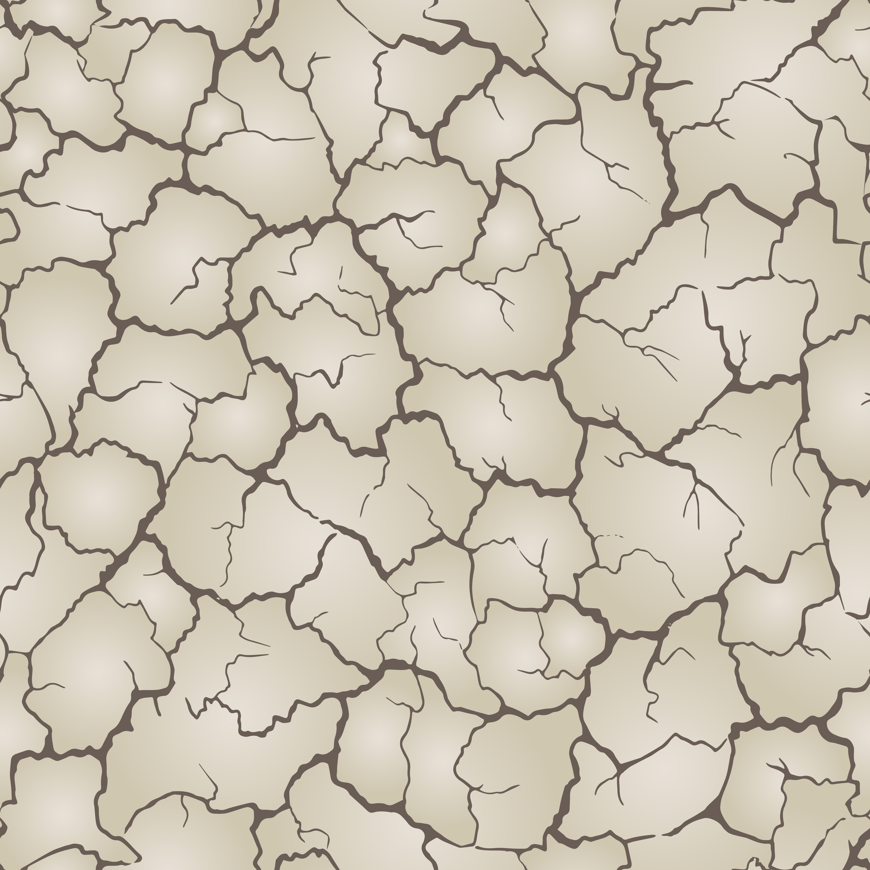
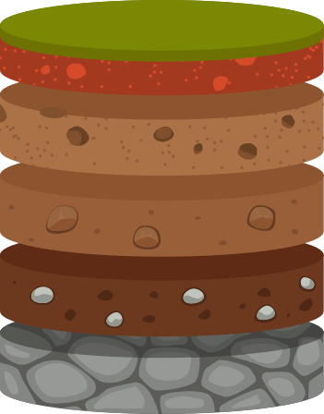

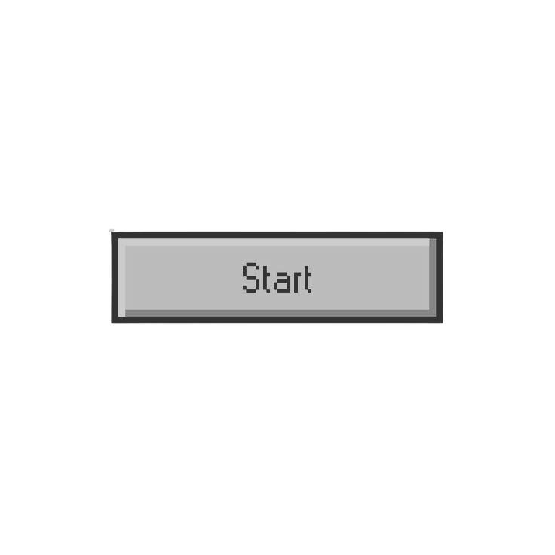
Struktur bumi, Data geolistrik & Abrasi untuk masa depan yang lebih aman

Slide 2
Identitas Peserta Didik
Nama
Kelas
MASUK

Slide 3
Halo, Test (Kelas IX)
Petunjuk
Tujuan
Materi
Simulasi
Evaluasi
Rangkuman
Profil

Slide 4
Petunjuk Penggunaan

Slide 5
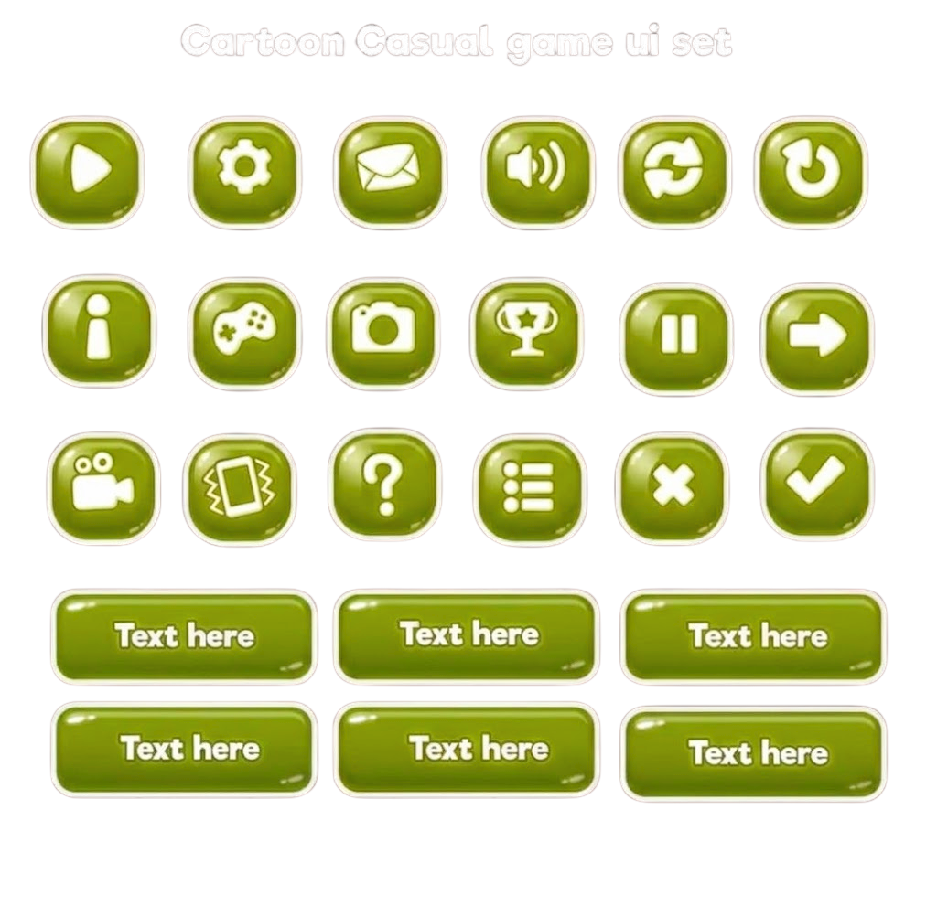
Tujuan Pembelajaran

Slide 6
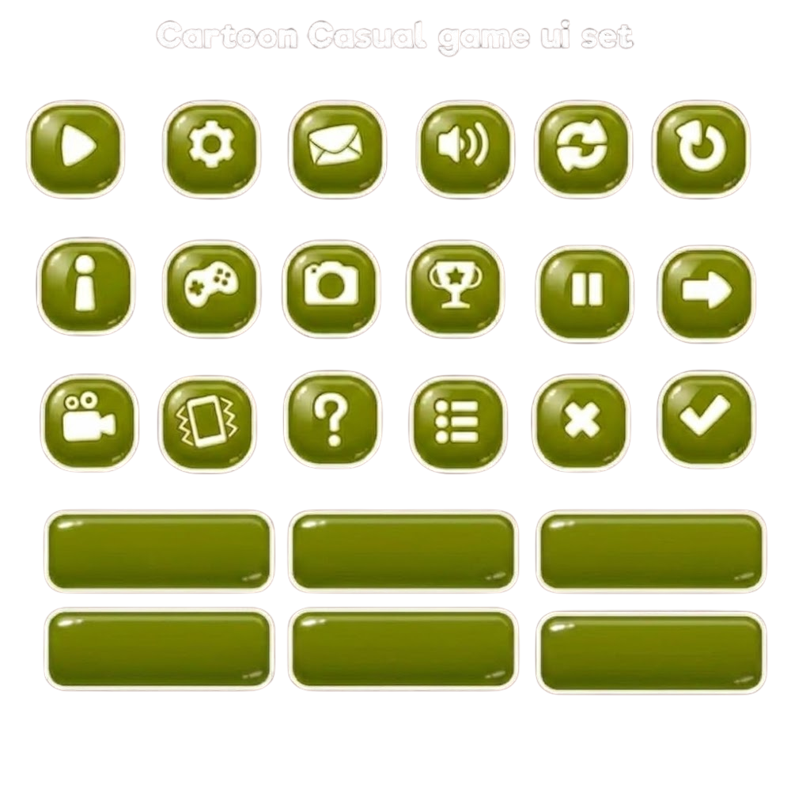
Tujuan Pembelajaran
Kembali

Slide 7

WHAT IS SOIL?
Soil is the loose material that covers much of the Earth’s surface. It is made up of tiny pieces of rock, dead plants and animals, water, and air. It important because plants grow in it, animals live in it, and people use it to build homes and grow food.

Slide 8

WHAT ARE SOIL HORIZON?
Soil horizons are the different layers in a soil profile. When you dig into the ground, you can see these layers. Each one looks and feels different because it has different materials. The layers are stacked on top of each other.

Slide 9
DIFFERENT SOIL HORIZONS

Slide 10
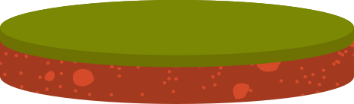
HORIZON O – ORGANIC LAYER
The top layer of soil is called Horizon O or the organic layer. It is made of leaves, plants, and dead animals that are breaking down. This layer is very important because it is full of nutrients that help plants grow.

Slide 11
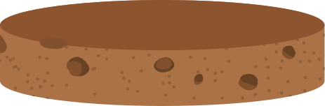
HORIZON A – TOPSOIL
Below the organic layer is Horizon A, also known as topsoil. This layer is dark and rich because it contains many nutrients and tiny living things like worms. Plants grow their roots here because it has what they need to grow strong.

Slide 12
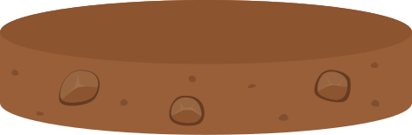
HORIZON B – SUBSOIL
Horizon B is called subsoil. It is found below the topsoil and has less organic material. This layer is made mostly of clay and minerals washed down from the layers above. It is usually lighter in color and harder than the topsoil.

Slide 13
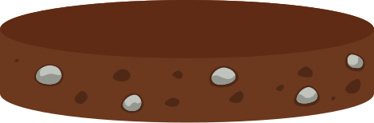
HORIZON C – PARENT MATERIAL
Horizon C is made up of weathered rock pieces. This layer is less broken down than the layers above. It is the parent material from which the soil forms over many years.

Slide 14
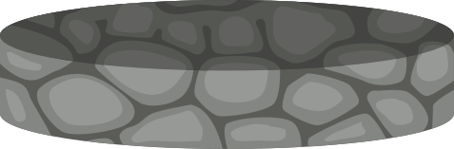
HORIZON R – BEDROCK
The deepest layer is Horizon R, which is solid bedrock. This layer is hard and unbroken. It forms the foundation under all the other soil layers.

Slide 15
THANK YOU
I hope you learn something new today!

